Slide 1
Opening Remarks
2026 DOELAP Personnel Dosimetry Training
Idaho Falls, ID
DAVID L. PUGH, CHP, NRRPT

Slide 2
Opening Remarks
The "Big Picture": Environment, Health, Safety and Security (EHSS) Mission
Environmental Compliance and Radiation Protection (EH-11) Mission & Function
The Process: Department of Energy Laboratory Accreditation Program (DOELAP) Accreditation Cycle
Role of the DOELAP Administrator
Key Takeaways & Discussion

Slide 3
EHSS Mission
Core Mandate: Protect DOE’s workers, the public, the environment, and national security assets.
How We Do It:
  Support implementation of effective strategies to accomplish work while protecting workers, the public, the environment, and security.
  Provide expert assistance and share lessons learned across the complex.
  Promote a strong safety culture where safe performance is deeply held by all.
EHSS is the Department's "environment, health, safety and security advocate."

Slide 4
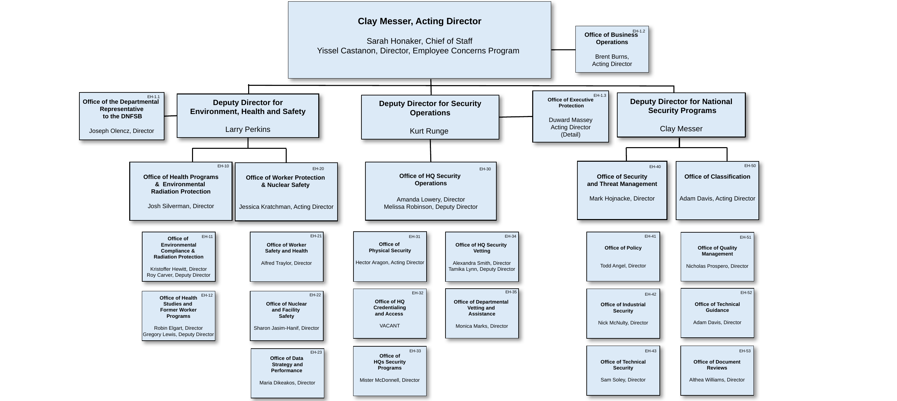
EHSS Organization Chart

Slide 5
EH-11
Office of Environmental Compliance and Radiation Protection:
  Previously, EH-22, Office of Public Radiation Protection.
  Now radiation protection for both occupational and public are under EH-11.
Key Radiation Protection Responsibilities:
  Provide technical advice and support effective implementation strategies.
  Administer the DOECAP (DOE Consolidated Audit Program).
  Administer the DOELAP (DOE Laboratory Accreditation Program).
  Participate in interagency, national, and international radiation protection initiatives.

Slide 6
EH-11 Rad (Office of Radiation Protection)
Tom Carver, EH-11 Rad Director and Acting ASP/DOECAP Manager
Mike Stewart, Public/Environmental Radiation Protection
Christine Lobos, Public/Environmental Radiation Protection
George Chiu, Occupational Radiation Protection
David Pugh, DOELAP Administrator and Occupational Radiation Protection

Slide 7
The DOELAP Accreditation Cycle
A continuous, multi-step process to ensure ongoing compliance and proficiency.
Accreditation is renewed on a triennial basis.
Four Key Phases:
  Application
  Performance Testing
  On-Site Assessment
  Accreditation Decision
Notes:
So, what exactly is DOELAP? It's our quality assurance program for radiation exposure monitoring. Its purpose is to make sure that when we measure a worker's radiation dose, that measurement is accurate and reliable, no matter which DOE site they're at. We accredit programs in both external dosimetry and radiobioassay. DOELAP ensures radiation exposure monitoring at DOE sites is consistent, accurate, and conforms to national standards.

Slide 8
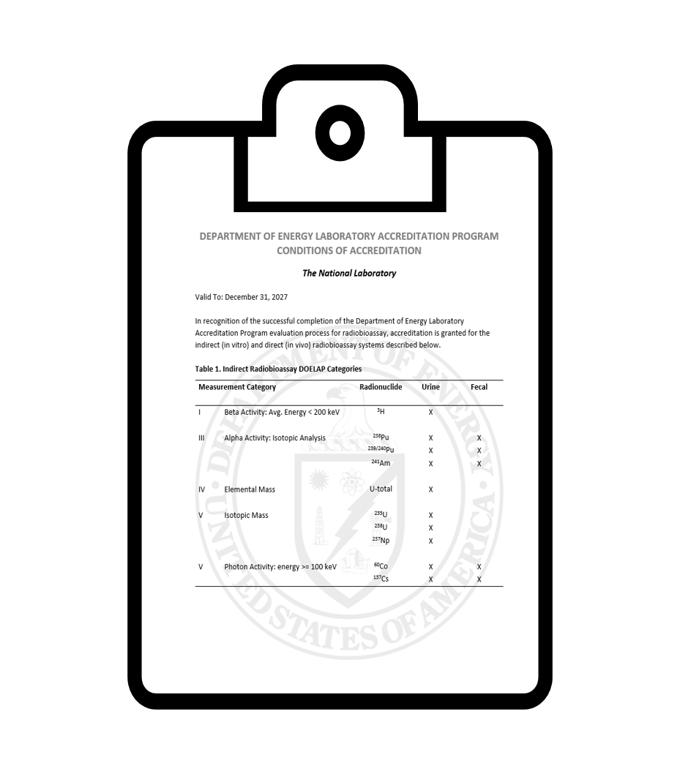
DOELAP Administrator
Per section 3.1, DOE-STD-1111, DOELAP Administration:
  Responsible for the development of policies, procedures, and standards necessary for the implementation and continued improvement of DOELAP.
  Makes the final decision on accreditation, amendments, technical equivalency, and appeals.
  Draft, sign, and issue DOELAP letters, memos, and accreditation paperwork.
  Appoints and removes Oversight Board members.
Work closely with the Senior Technical Manager and the Director of RESL.

Slide 9

DOELAP Administration
Success in DOELAP is a team effort:
  Radiological and Environmental Sciences Lab
  EH-11
  Oversight Board
  DOELAP Assessors
  DOE Program and Field Offices
  Personnel dosimetry and radiobioassay programs across the complex.
Notes:
DOELAP established in 1986 to ensure monitoring across the complex is:
Consistent,
Accurate, and
Conforms to accepted standards.
DOELAP’s continued success as the gold standard for accreditation is a team effort:
Office of Environment, Health, Safety, and Security,
Radiological and Environmental Sciences Laboratory,
Oversight Board,
Assessors,
DOE Site Office Managers,
Dosimetry Programs across the complex.

Slide 10
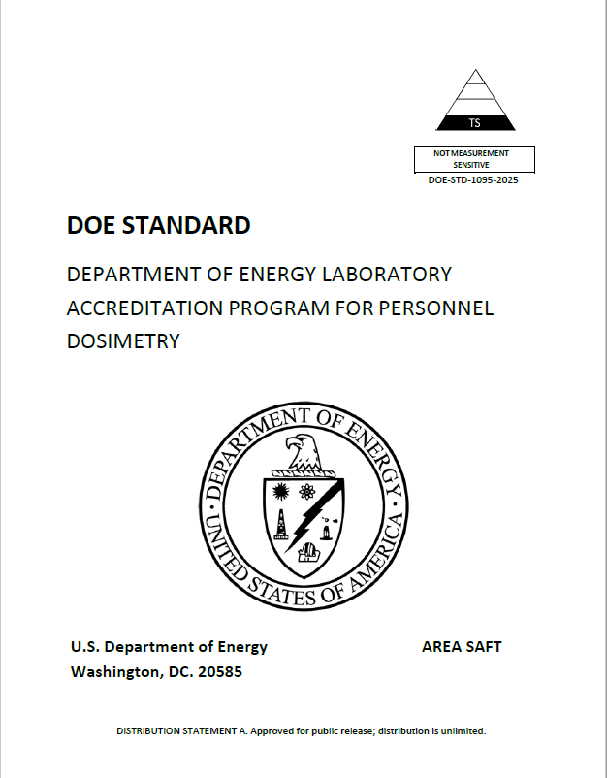
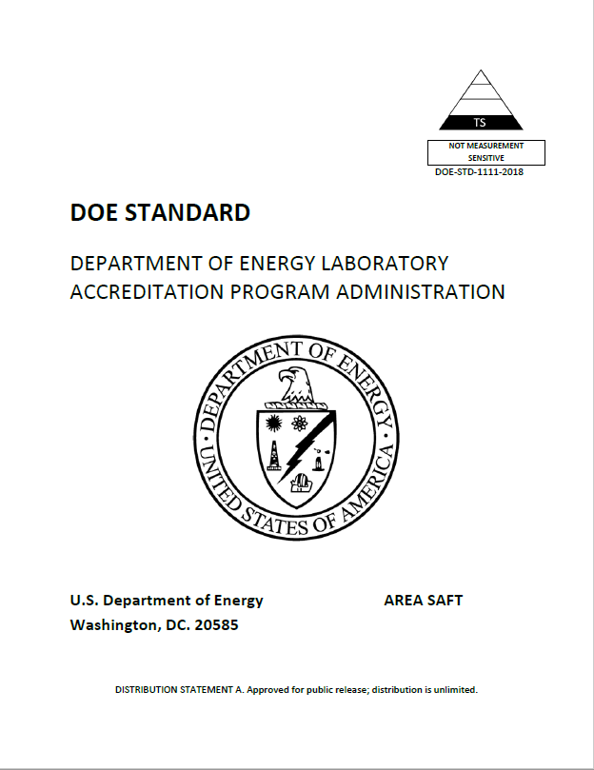
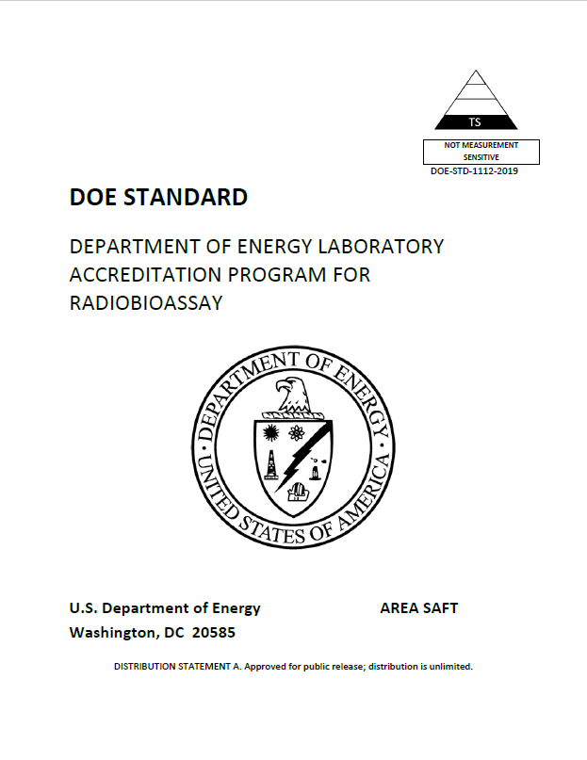
DOELAP Standards

Slide 11
DOELAP Oversight Board
Current Membership
  Milan Gadd, LANL – OSB Chair
  Michael Souleyrette, Y-12
  Kelly Crandall, SRS
  Cheryl Antonio, HMIS
  Nathan Elliott, SNL
  Ken Veinot, Y-12
  Richard Pierson, PNNL
  Adam Stavola, TJNAF
  Julie Strock, INL (New Member)
  Jaimie Daum, ORNL (New Member)

Slide 12
Contact Information
david.pugh1@hq.doe.gov
(301) 903-7339
DO NOT send emails or meeting invites to david.pugh@nnsa.doe.gov.

